Slide 1
Proposal 3
The Basics
Camilla, Alex, Cameron

Slide 2
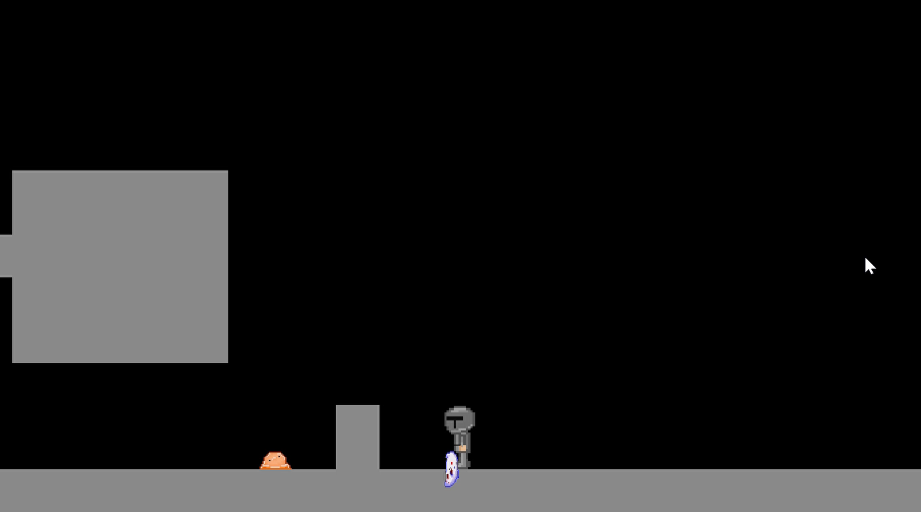
This Week’s Goals – Finalizing our first level
Background – Already Started!
HUD – Health Bar, Weapon Inventory (?), Something to keep track of our powerups
Troubleshoot our Ghost Enemy – They’re not doing so well...
Sort out our Level Design
Figure out level dimensions
Parkour Additions
Make things a level instead of an enemy test!
Begin working on Weapons, Bullets, etc.
SFX maybe?
Potentially figuring out weapon drop percentages

Slide 3
Why Do These Changes Matter
They complete our first main goal! We hope to have at least have our level design and background finished by next demo
They finally add playability and hopefully a win/lose condition
We can finally work on making this game rouge-like platformer.

Slide 4
Icons
Of course, not picked out yet...

